Slide 1
The foxtrot
Lesley Johnson senate lekomola Brandon Barbosa
(hacker) (hipster) (hacker)
moses m. pule Tshepang Letlole
(hipster) (hustler)

Slide 2
…………….
Just buying some time so…
……………

Slide 3

Waiting for your cargo to arrive its like attending a pizzathon

Slide 4
the hard wonderful life
As computer scientists , we solve problems
Its because of such problems that we can pride
The problem that we faced was that many delivering companies missed individuals who needed their services and individuals suffered because of that issue and …

Slide 5

HENCE OUR WEB DESIGN WILL TURN A ☹ INTO A ☺ LEAVING EVERYBODY HAPPY

Slide 6
solution
The issue of using a web based application was that we thought that it would be easier to solve the problem as compared to making a mobile application as so we thought!!!
Our application allows a user to access the delivering company services without looking tediously for them
It also allows the delivering companies to see when and where an individual needs their help

Slide 7
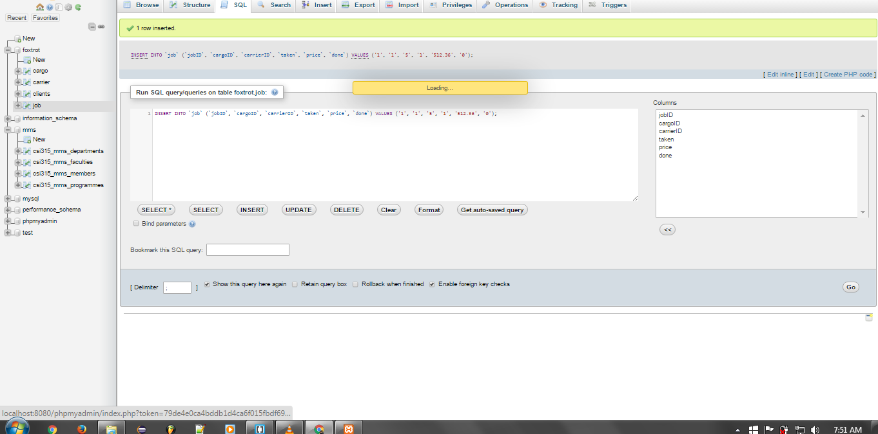
The application

Slide 8
